Slide 1
Gauss Quadrature Rule of Integration
by
Dr. Md. Rajibul Islam
CSE, UAP

Slide 2

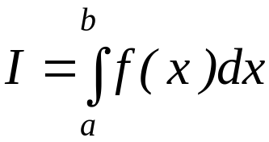
What is Integration?
Integration
y
f(x)
The process of measuring the area under a curve.
Where:
f(x) is the integrand
a= lower limit of integration
b= upper limit of integration
a
b
x

Slide 3
Two-Point Gaussian Quadrature Rule

Slide 4
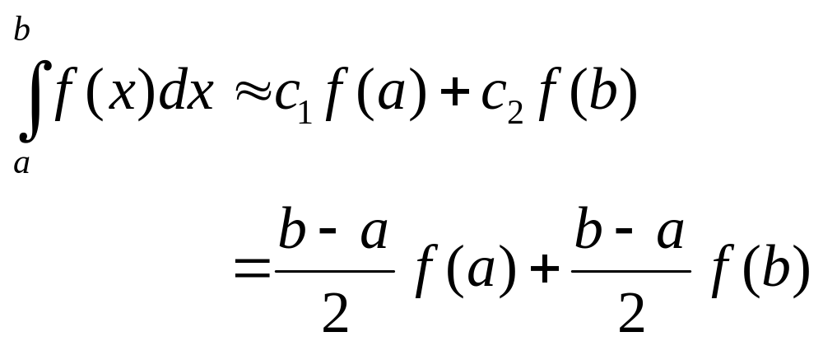


Basis of the Gaussian Quadrature Rule
Previously, the Trapezoidal Rule was developed by the method
of undetermined coefficients. The result of that development is
summarized below.
Give some weight to
Give some weight to

Slide 5
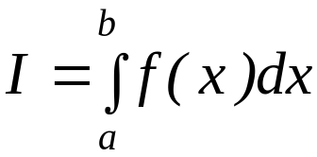

Basis of the Gaussian Quadrature Rule
The two-point Gauss Quadrature Rule is an extension of the Trapezoidal Rule approximation where the arguments of the function are not predetermined as a and b but as unknowns
x₁ and x₂. In the two-point Gauss Quadrature Rule, the integral is approximated as

Slide 6

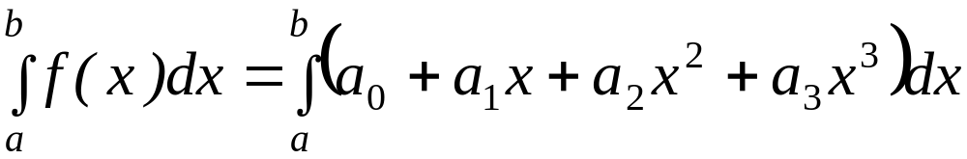
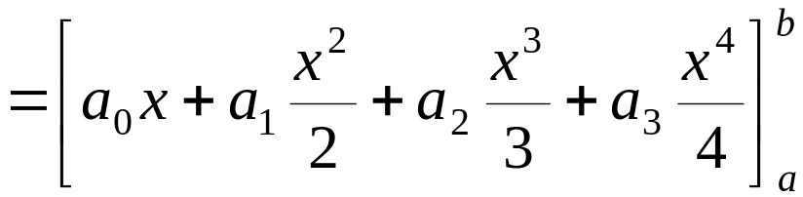
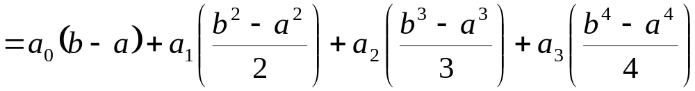
Basis of the Gaussian Quadrature Rule
The four unknowns x₁, x₂, c₁ and c₂ are found by assuming that the formula gives exact results for integrating a general third order polynomial,
Hence

Slide 7
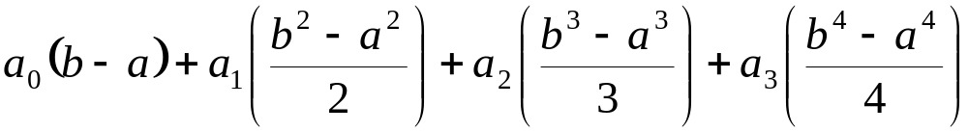
Basis of the Gaussian
Quadrature Rule
It follows that
Equating Equations the two previous two expressions yield

Slide 8
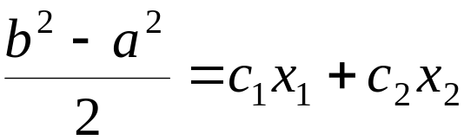

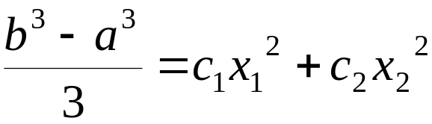
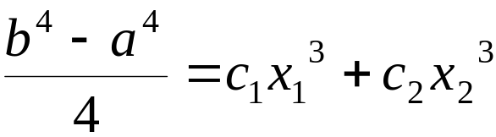
Basis of the Gaussian Quadrature Rule
Since the constants a₀, a₁, a₂, a₃ are arbitrary

Slide 9
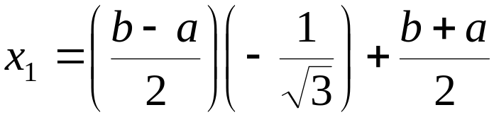
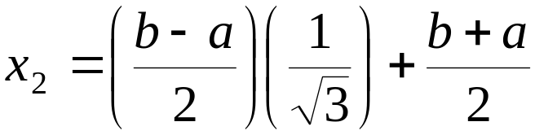
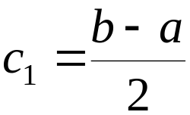
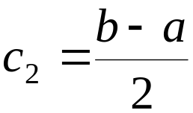
Basis of Gauss Quadrature
The previous four simultaneous nonlinear Equations have only one acceptable solution,

Slide 10
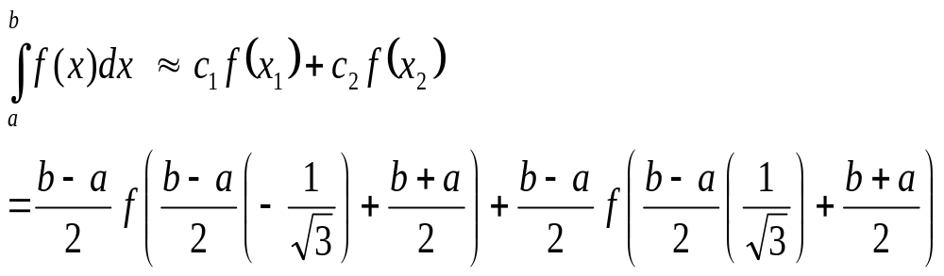
Basis of Gauss Quadrature
Hence Two-Point Gaussian Quadrature Rule

Slide 11
Higher Point Gaussian Quadrature Formulas

Slide 12
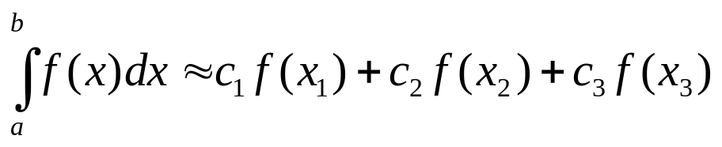
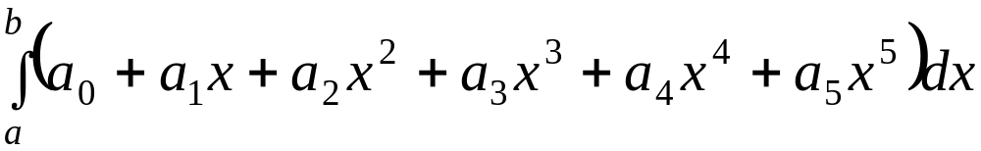
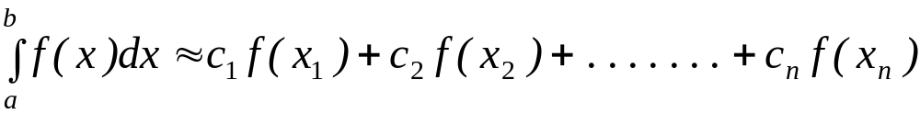
Higher Point Gaussian Quadrature Formulas
is called the three-point Gauss Quadrature Rule.
The coefficients c₁, c₂, and c₃, and the functional arguments x₁, x₂, and x₃
are calculated by assuming the formula gives exact expressions for
integrating a fifth order polynomial
General n-point rules would approximate the integral

Slide 13
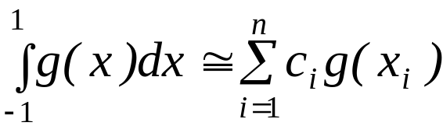
Arguments and Weighing Factors for n-point Gauss Quadrature Formulas
Table 1: Weighting factors c and function
arguments x used in Gauss Quadrature
Formulas.
In handbooks, coefficients and
arguments given for n-point
Points | Weighting Factors | Function Arguments
2 | c₁ = 1.000000000 c₂ = 1.000000000 | x₁ = -0.577350269 x₂ = 0.577350269
3 | c₁ = 0.555555556 c₂ = 0.888888889 c₃ = 0.555555556 | x₁ = -0.774596669 x₂ = 0.000000000 x₃ = 0.774596669
4 | c₁ = 0.347854845 c₂ = 0.652145155 c₃ = 0.652145155 c₄ = 0.347854845 | x₁ = -0.861136312 x₂ = -0.339981044 x₃ = 0.339981044 x₄ = 0.861136312
Gauss Quadrature Rule are
given for integrals
as shown in Table 1.

Slide 14
Arguments and Weighing Factors for n-point Gauss Quadrature Formulas
Table 1 (cont.) : Weighting factors c and function arguments x used in Gauss Quadrature Formulas.
Points | Weighting Factors | Function Arguments
5 | c₁ = 0.236926885 c₂ = 0.478628670 c₃ = 0.568888889 c₄ = 0.478628670 c₅ = 0.236926885 | x₁ = -0.906179846 x₂ = -0.538469310 x₃ = 0.000000000 x₄ = 0.538469310 x₅ = 0.906179846
6 | c₁ = 0.171324492 c₂ = 0.360761573 c₃ = 0.467913935 c₄ = 0.467913935 c₅ = 0.360761573 c₆ = 0.171324492 | x₁ = -0.932469514 x₂ = -0.661209386 x₃ = -0.2386191860 x₄ = 0.2386191860 x₅ = 0.661209386 x₆ = 0.932469514

Slide 15
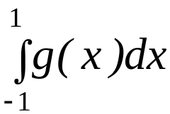
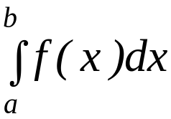







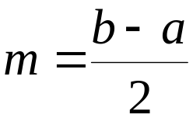
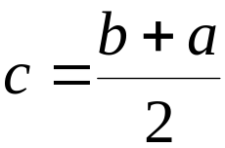
Arguments and Weighing Factors for n-point Gauss Quadrature Formulas
So if the table is given for
integrals, how to convert this to
?
The answer lies in that any integral with limits of
can be converted into an integral with limits
Let
Here, m, is for the contract or expand of your interval, and
c, is the direction (Left/ right)
If then
Such that:
If then
a=m(-1)+c …… (i)
b=m(+1)+c…….(ii)
Then

Slide 16
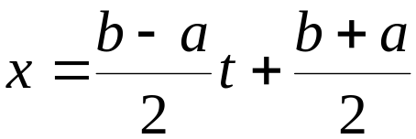
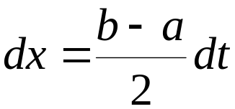
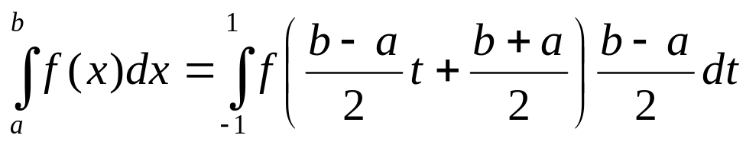
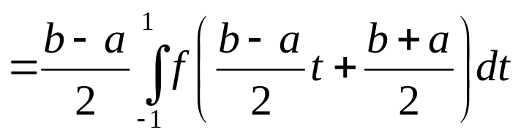
Arguments and Weighing Factors for n-point Gauss Quadrature Formulas
Hence
Substituting our values of x, and dx into the integral gives us

Slide 17
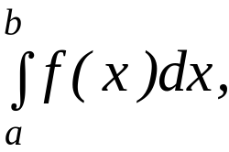
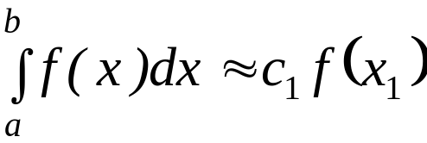
Example 1
For an integral
derive the one-point Gaussian Quadrature
Rule.
Solution
The one-point Gaussian Quadrature Rule is

Slide 18

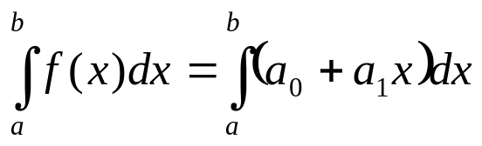
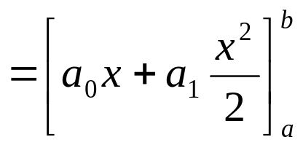
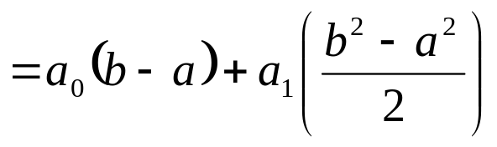
Solution
The two unknowns x₁, and c₁ are found by assuming that the formula gives exact results for integrating a general first order polynomial,

Slide 19
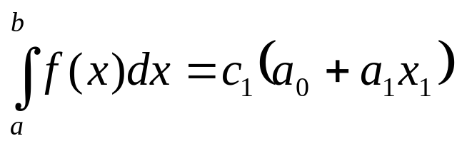
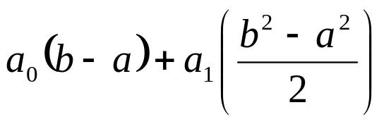

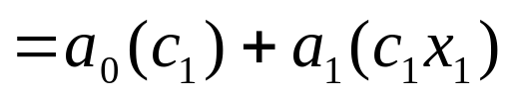
Solution
It follows that
Equating Equations, the two previous two expressions yield

Slide 20
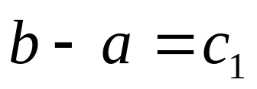
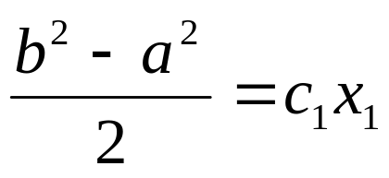

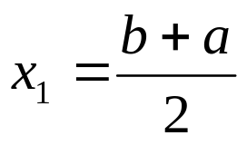
Basis of the Gaussian Quadrature Rule
Since the constants a₀, and a₁ are arbitrary
…………. (i)
…………. (ii)
giving

Slide 21
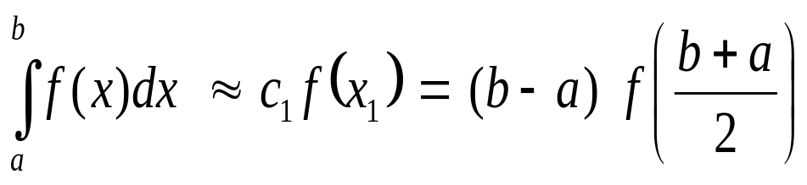
Solution
Hence One-Point Gaussian Quadrature Rule

Slide 22
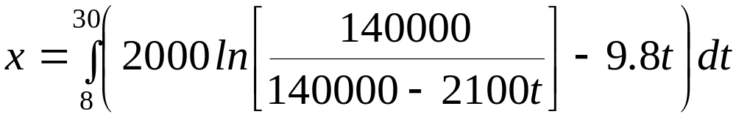


Example 2
a)
Use two-point Gauss Quadrature Rule to approximate the distance
covered by a rocket from t=8 to t=30 as given by
Find the true error, for part (a).
Also, find the absolute relative true error, for part (a).
b)
c)

Slide 23
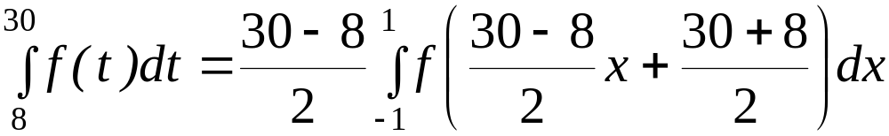
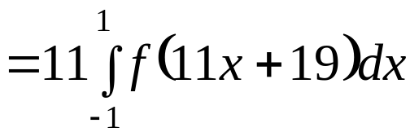
Solution
First, change the limits of integration from [8,30] to [-1,1]
by previous relations as follows

Slide 24




Solution (cont)
Next, get weighting factors and function argument values from Table 1
for the two point rule,

Slide 25
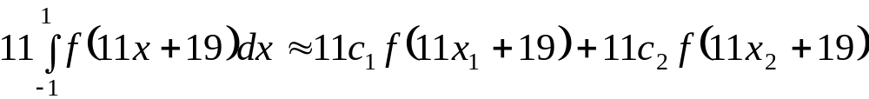

Solution (cont.)
Now we can use the Gauss Quadrature formula

Slide 26
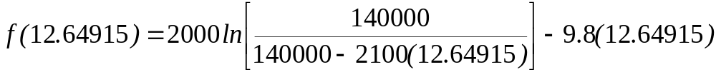

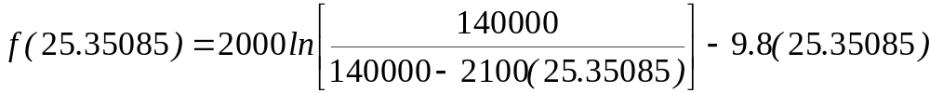

Solution (cont)
since

Slide 27



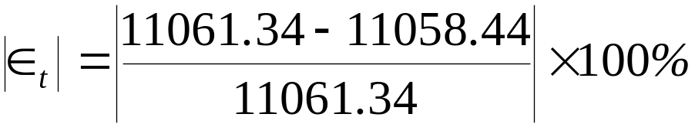

Solution (cont)
b)
The true error, , is
c)
The absolute relative true error,
, is (Exact value = 11061.34m)

Slide 28
THE END

